Slide 1
BHARATI VIDYAPEETH DEEMED UNIVERSITY COLLEGE OF ENGINEERING PUNE
DEPARTMENT OF ELECTRONICS AND TELECOMMUNICATION ENGINEERING
IoT Based Patient Health Monitoring using ESP8266 & Arduino
Guided By :-
Prof. PD Kadam
Project By :-
1.Krishna Mani Raj ( Roll No. 46 )
2.Kaushal Kumar ( Roll No. 45 )
3.Manan Agrwal (Roll No. 50)

Slide 2
Introduction :-
IoT based patient health monitoring system is a generic term given to any medical equipment that has internet capability and can measure one or more health data of a patient who is connected to the device such as heartbeat, body temperature, blood pressure, ECG, steps etc.
The equipment can record, transmit and alert if there is any abrupt change in the patient’s health.
IoT based health monitoring system is used where the patient and heath expert(s) are at different locations.
For example, a patient can stay at home and continue his/her routine life and a doctor can monitor patient’s heath. Based on the received data the heath expert can prescribe a best treatment or take an immediate action in case of an emergency.

Slide 3
Materials required
Arduino Uno and Programming Cable
ESP8266 Wi-Fi module
LM35 temperature sensor
Pulse rate sensor
Push button
10k Resistor
Male-female wires
Breadboard

Slide 4
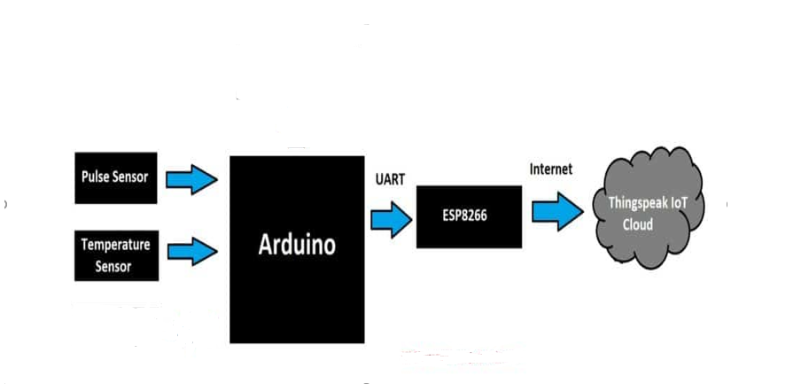
Block diagram

Slide 5
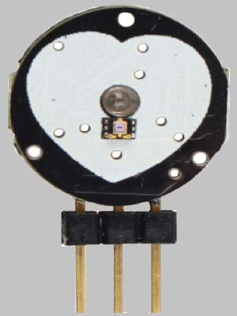
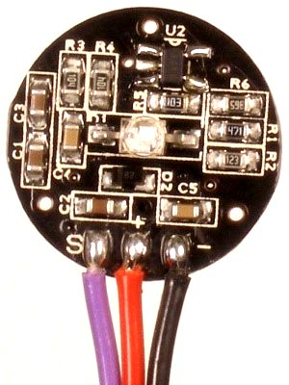
Pulse sensor:
The pulse sensor / heartbeat sensor is an inexpensive analog sensor which can measure reasonably accurate pulse rate of human heart with the help of a microcontroller.
A microcontroller like Arduino can be programmed to calculate its analog output to BPM or beats per minute.
It can operate from 3.3V to 5V, but here we are connecting it to 5V supply. It has just 3 pins: Vcc, GND and signal (Analog out).

Slide 6
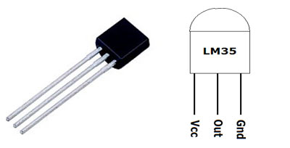
LM35 Temperature Sensor
We are using a general purpose water proof digital temperature sensor DS18B20 to measure body heat which comes in a sealed metallic enclosure.
Measuring body temperature can reveal a lot about patient’s health and a healthcare professional can identify abnormalities in a patient’s health

Slide 7
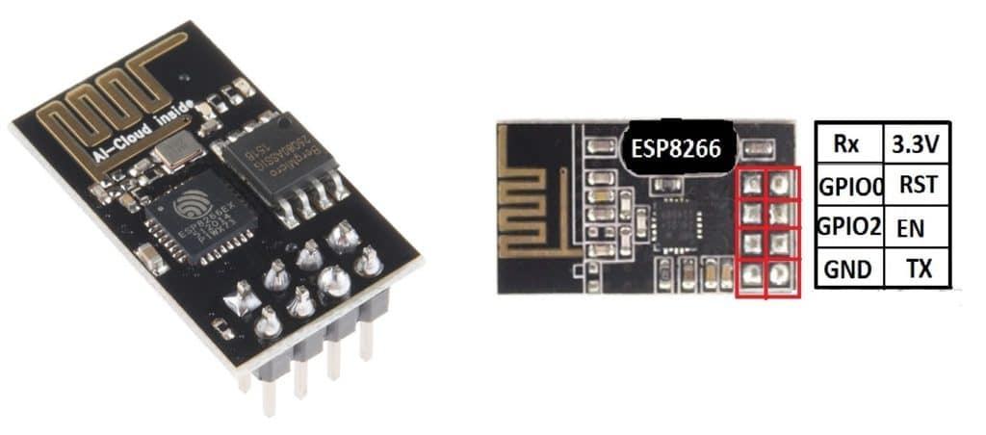
ESP8266-01 WIfi module
The ESP8266 is a very user-friendly and low-cost device to provide internet connectivity to your projects.
The module can work both as an Access point (can create hotspot) and as a station (can connect to Wi-Fi), hence it can easily fetch data and upload it to the internet making the Internet of Things as easy as possible.

Slide 8
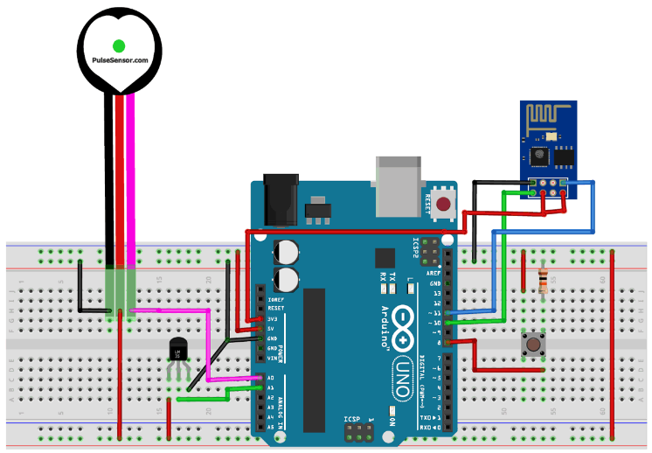
Circuit Diagram

Slide 9
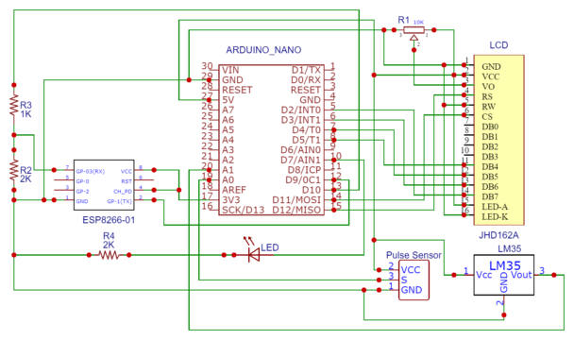
Schematic designed using EasyEDA software

Slide 10
Advantages:-
Cost Reduction: IoT enables patient monitoring in real time, thus significantly cutting down unnecessary visits to doctors, hospital stays and re-admissions
Improved Treatment: It enables physicians to make evidence-based informed decisions and brings absolute transparency
Faster Disease Diagnosis: Continuous patient monitoring and real time data helps in diagnosing diseases at an early stage or even before the disease develops based on symptoms
Proactive Treatment: Continuous health monitoring opens the doors for providing proactive medical treatment
Error Reduction: Data generated through IoT devices not only help in effective decision making but also ensure smooth healthcare operations with reduced errors, waste and system costs

Slide 11
DisAdvantages:-
1. Privacy of Data. Privacy is the biggest challenge with IoT, as all the connected devices transfer data in real-time. Personal data can be hacked if this end to end connection is not secure. Criminals can use this personal data of others for their own benefits. 2. Accuracy Accuracy issues may come due to handling such massive data in real-time. 3. Cost IoT may reduce the cost for diagnosis and treatment for patients, But the cost of installing all the devices and their maintenance is quite high.

Slide 12
Applications:-
IOT Healthcare is the most demanding field in the medical area. This project is for, elderly people in our home. Also, for the senior citizen living alone or living with 1 or 2 members. This project really proves helpful when family members need to go out for some emergency work.
Disable patients can use this project. Disable patients who find it really difficult to go to doctors on a daily basis or for those patients who need continuous monitoring from the doctor.

Slide 13
THANK YOU

